Slide 1

BEATS, HOPS ‘N’ CODE
BOWLING GAME CODE KATA

Slide 2
AGENDA
AGENDA
BEATS, HOPS ‘N’ CODE
1
2
3
4
Bowling Game
Mechanics
Showtime
Contact

Slide 3
CYMBAL
PRODUCT OVERVIEW
BOWLING GAME
CODE KATA
BEATS, HOPS ‘N’ CODE

Slide 4
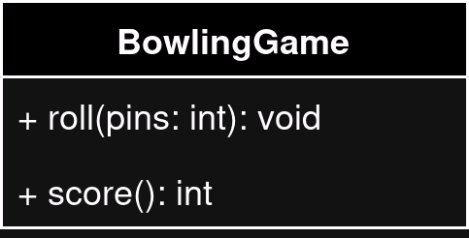
CODE KATA
BEATS, HOPS ‘N’ CODE
Class design
RULES
Game has 10 frames
2 throws for each frame
Score for the frame is the total number of pins knocked down

Slide 5
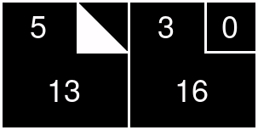
CODE KATA
BEATS, HOPS ‘N’ CODE
Score
SPARE
10 pins knocked in 2 rolls
Score for the frame is 10 plus the pins knocked down on the next roll
5 + 5 + 3 = 13

Slide 6
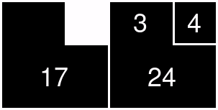
CODE KATA
BEATS, HOPS ‘N’ CODE
Score
STRIKE
10 pins knocked in one roll
Score for the frame is 10 plus the pins knocked down on the next 2 rolls
10 + 3 + 4 = 17

Slide 7
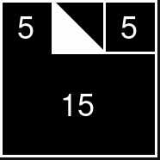
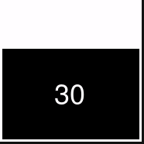
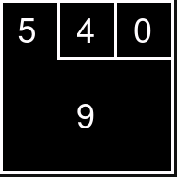
CODE KATA
BEATS, HOPS ‘N’ CODE
Score
10TH FRAME
If a player rolls a strike or spare, they are allowed to roll the extra balls to complete the frame
No more than 3 balls can be rolled

Slide 8
CYMBAL
PRODUCT OVERVIEW
MECHANICS
CODE KATA
BEATS, HOPS ‘N’ CODE

Slide 9
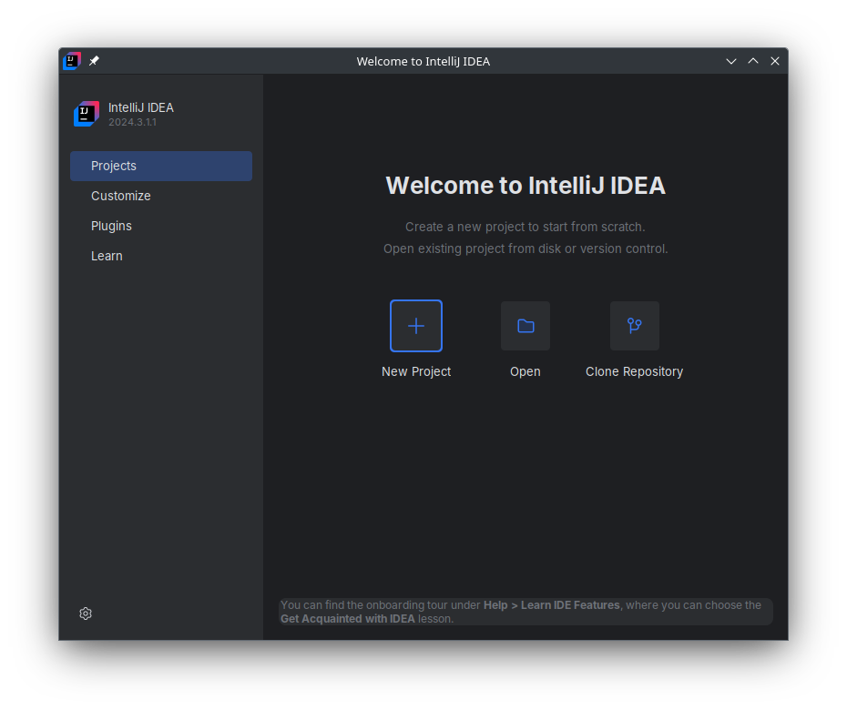
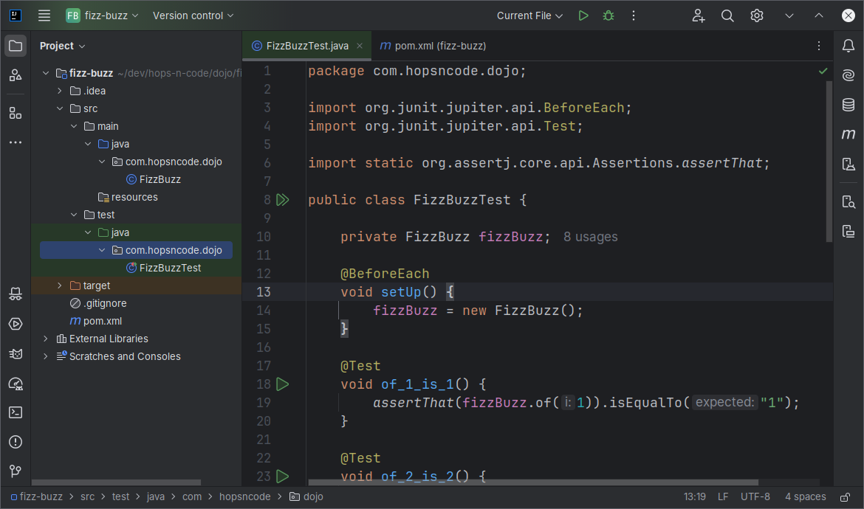
MECHANICS
PROBLEM & SOLUTION
WHO WE ARE
Work on your own IDE
Follow along
Pauses for quick questions
Pay close attention!

Slide 10
CYMBAL
PRODUCT OVERVIEW
SHOWTIME
CODE KATA
BEATS, HOPS ‘N’ CODE

Slide 11
CODE KATA
BEATS, HOPS ‘N’ CODE
BEATS, HOPS ‘N’ CODE
César Romero
hops.n.code@gmail.com
https://github.com/hops-n-code

